Slide 1
Software Engineering
Topic 8: Project Management
Notes:
NCC Education - Title Master

Slide 2
The Unit Roadmap
Topic 1: Introduction
Topic 2: Introduction to Software Engineering Key Practices and Principles
Topic 3: Software Development Life Cycle Models
Topic 4: Requirement Engineering
Topic 5: System Modelling & Design
Topic 6: Software Implementation & Testing
Topic 7: System Dependency and Security
Topic 8: Project Management
Topic 9: Mini Project 1
Topic 10: Mini Project 2
Topic 11: Mini Project 3
Topic 12: Mini Project 4

Slide 3
Recap on Topic 7
The dependability of a system reflects the user’s degree of trust in that system. What are dependency attributes?
Dependable process are set of procedures and activities in SDLC to ensure software does not fail. What are dependency process characteristics?
Formal methods are approaches to software development that are based on mathematical representation and analysis of software. What is system specification?
Along with formal methods to ensure software equality there are practices to ensure security quality of software. Name some of them and the relevant SDLC stage of each.

Slide 4
Learning Outcomes
By the end of this topic students will be able to:
Describe project management tools and methods for ensuring software quality (Planning, monitoring, control, risk, quality, organisation)
Explain risk assessment and control
Explain methods and techniques for software testing and change management (quality, monitoring & control)
Discuss the role of documentation in software engineering (Risk register, Gantt chart etc

Slide 5
Scope and Coverage
This topic will cover:
Project Planning: Scheduling, Estimating, Gantt charts.
Risk assessment and management
Teamwork
Quality management
Notes:
NCC Education - Slide Master

Slide 6
What is a Project?
Project is a temporary endeavour (PMBOK)
undertaken to create a unique product, service, or result.
It typically has a defined beginning and end, with specific objectives to be achieved within constraints such as time, cost, and resources.
Projects are often managed using established processes and methodologies to ensure successful completion and delivery of the desired outcome.

Slide 7
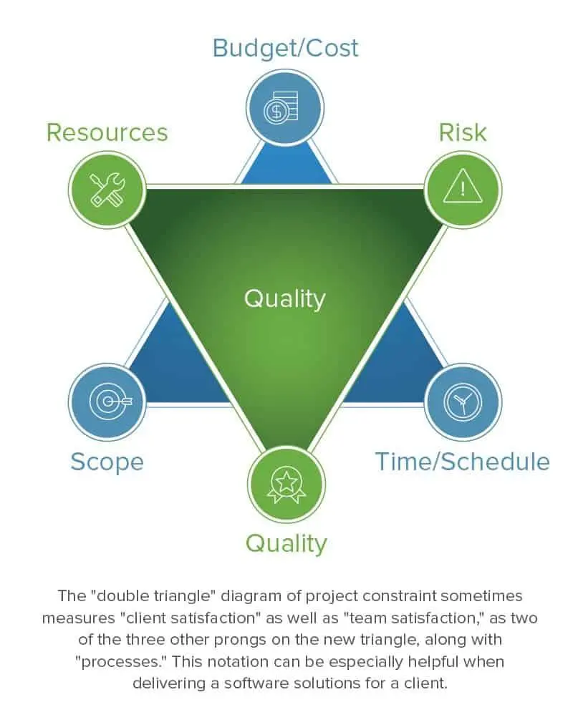
Project Management
Project Management Triangle," also known as the "Triple Constraint" or "Iron Triangle
3 primary constraints of a project: scope, time, and cost.
Interrelated constraints : increase the scope -> more time -> more costs
Project manager should balance these constraints.
Six-pointed stars captures 3 additional important influences of risk, resource and quality.
Smartsheet.com

Slide 8
Software Project Management
Concerned with activities involved in ensuring that software is delivered on time and on schedule and in accordance with the requirements (scope)
Needed because software development is always subject to budget and schedule constraints that are set by the organisation developing the software.

Slide 9
Success Criteria
Deliver the software to the customer at the agreed time.
Keep overall costs within budget.
Deliver software that meets the customer’s expectations.
Maintain a coherent and well-functioning development team.

Slide 10
Software Management Distinctions
The product is intangible.
Software cannot be seen or touched. Software project managers cannot see progress by simply looking at the artefact that is being constructed.
Many software projects are 'one-off' projects.
Large software projects are usually different in some ways from previous projects. Even managers who have lots of previous experience may find it difficult to anticipate problems.
Software processes are variable and organisation specific.
We still cannot reliably predict when a particular software process is likely to lead to development problems.

Slide 11
Factors Influencing Project Management
Company size
Software customers
Software size
Software type
Organisational culture
Software development processes
These factors mean that project managers in different organisations may work in quite different ways.

Slide 12
Project Management Activities
Project planning
Project managers are responsible for planning, estimating and scheduling project development and assigning people to tasks.
Risk management
Project managers assess the risks that may affect a project, monitor these risks and take action when problems arise.
People management
Project managers must choose people for their team and establish ways of working that leads to effective team performance.

Slide 13
Management Activities
Reporting
Project managers are usually responsible for reporting on the progress of a project to customers and to the managers of the company developing the software.
Proposal writing
The first stage in a software project may involve writing a proposal to win a contract to carry out an item of work. The proposal describes the objectives of the project and how it will be carried out.
Quality Management
The systematic process of ensuring that products or services consistently meet or exceed customer expectations and organizational standards.

Slide 14
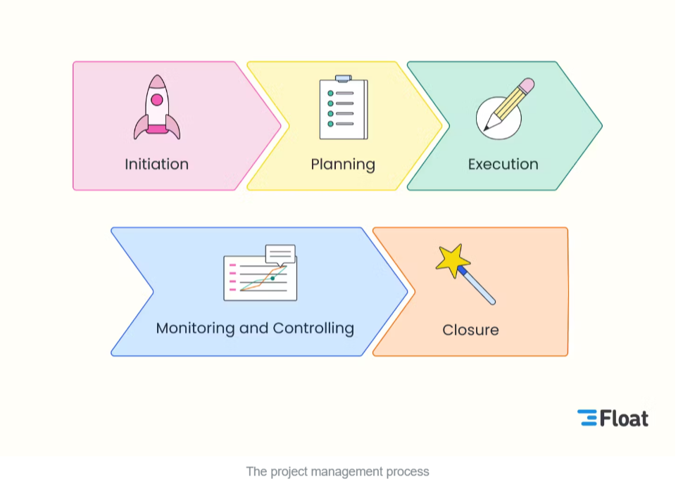
The project management process
Project Management Process

Slide 15

Project Planning
Project plans crucial to ensure unified understanding of objectives.
Provide clarity regarding the roles and responsibilities of both team members and stakeholders involved in the project.
Planning steps:
Determine the project goals and objectives
Determine the project scope
Determine the project activities and tasks
Build your Work Breakdown Structure (WBS)
Set timelines for tasks
Allocate tasks to team members and resources
Estimate efforts
Risk assessment
plan quality control management
Plan communication

Slide 16
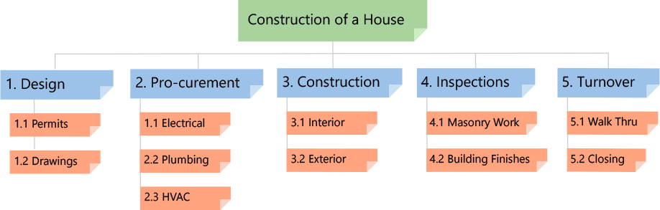
Work Breakdown Structure (WBS)
https://www.workbreakdownstructure.com/

Slide 17
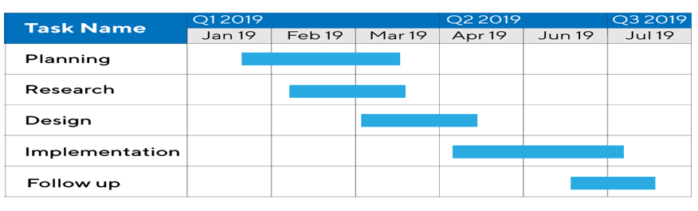
Gantt Chart
Productplan.com
A Gantt chart, is a bar chart that graphically illustrates a schedule for planning, coordinating, and tracking specific tasks related to a single project.
Designed by Henry Gantt, an American mechanical engineer
An information radiator that acts as an important document in project reporting to show project plan and progress

Slide 18
Estimation
To forecast the efforts
We cannot eliminate uncertainty from estimates, but they embrace the idea that small efforts are rewarded with big gains.
Estimation methods:
Expert Opinion: If you want to know how long something is likely to take, ask an expert
Analogous Estimation: by comparing with similar projects
Parametric Estimation: uses historical information along with statistical data.
Bottom-Up Estimation: the number of hours of each single activity is determined with the greatest level of detail at the bottom level

Slide 19
Overestimate
TIME +
High Time – Loss of resources
High cost – Wastage of money
OVERESTIMATE
High Time – Loss of resources
Low cost – Impact on Profit
COST -
COST +
Less Time – Impact on delivery
Less cost – Impact on Profit
Less Time – Impact on delivery
High cost – Wastage of money
TIME -
Ghanashyam Hinge, Project Estimation
Notes:
Estimation closer to the center (Bigger star) is always a good estimation

Slide 20
Risk Management
Identifying and estimating risks and drawing up plans to control their effect on a project.
Important because of the inherent uncertainties in software development.
These uncertainties stem from loosely defined requirements, requirements changes due to changes in customer needs, difficulties in estimating the time and resources required for software development, and differences in individual skills.
You must anticipate risks, understand the impact of these risks on the project, the product and the business, and take steps to control these risks.

Slide 21
Risk Classification
There are two dimensions of risk classification
The type of risk (technical, organisational, ..)
What is affected by the risk
Project risks affect schedule or resources and the quality or performance of the software being developed;
Business risks affect the organisation developing or procuring the software.
But what is risk?
According to ISO 31000:2018, risk is defined as the effect (Impact) of uncertainty (likelihood) on objectives, where an "effect" is a deviation from the expected — positive or negative.
Risk assessment: Risk = Likelihood x Impact

Slide 22
Examples Of Project, Product, And Business Risks
Risk | Affects | Description
Staff turnover | Project | Experienced staff will leave the project before it is finished.
Management change | Project | There will be a change of organizational management with different priorities.
Hardware unavailability | Project | Hardware that is essential for the project will not be delivered on schedule.
Requirements change | Project and product | There will be a larger number of changes to the requirements than anticipated.
Size underestimate | Project and product | The size of the system has been underestimated.
Technology change | Business | The underlying technology on which the system is built is superseded by new technology.
Product competition | Business | A competitive product is marketed before the system is completed.
Sommerville, 2016

Slide 23
The Risk Management Process
Risk identification
Identify project, product and business risks;
Risk analysis
Assess the likelihood and consequences of these risks;
Risk planning
Draw up plans to avoid or minimise the effects of the risk;
Risk monitoring
Monitor the risks throughout the project;

Slide 24




The Risk Management Process
(Sommerville, 2016 )

Slide 25
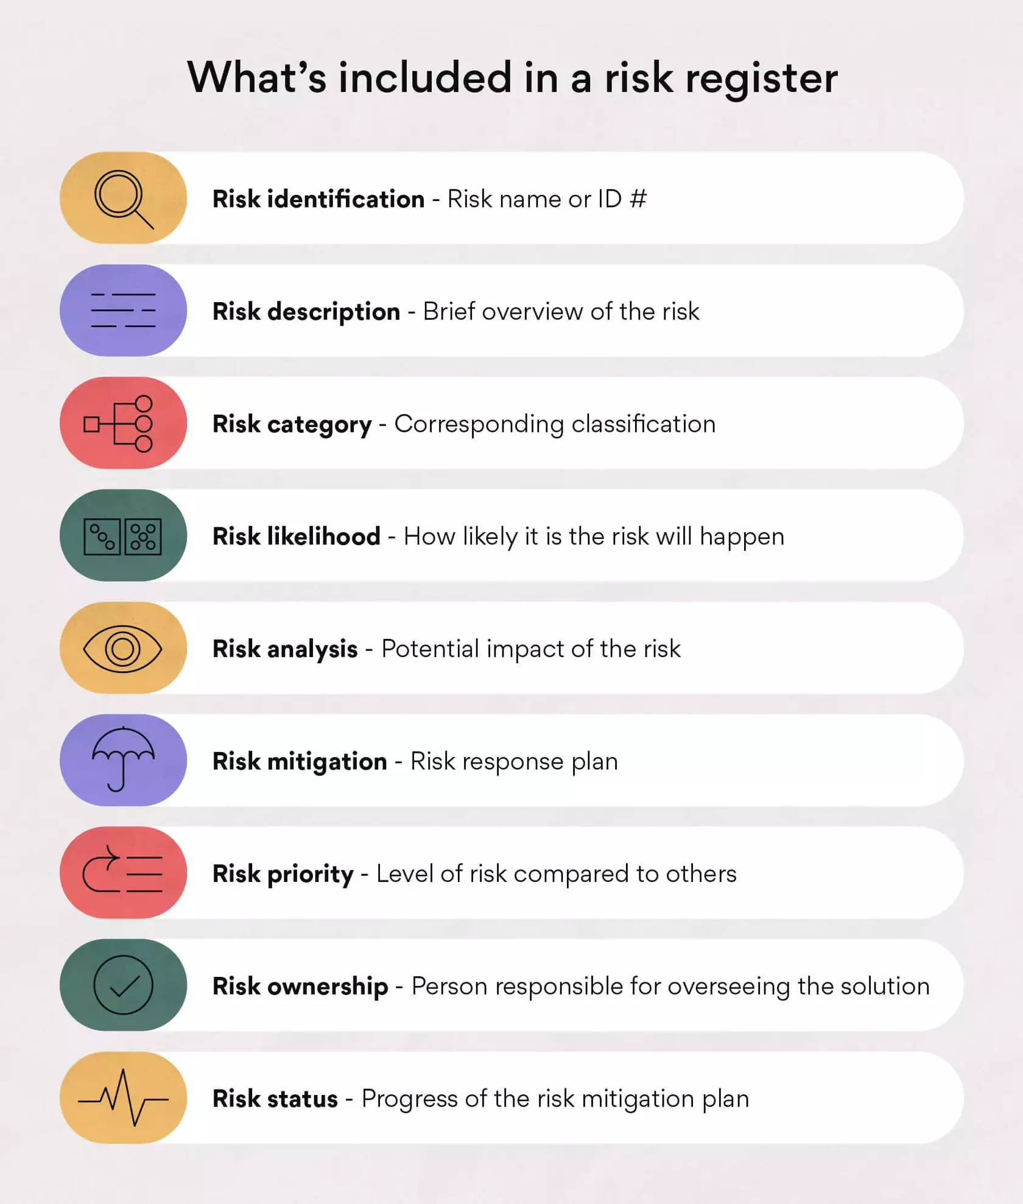
Risk Register
Risk register is a document that is used as a risk management tool to identify potential setbacks within a project.
Tracks potential risks specifically within a project.
It also includes information about the priority of the risk and the likelihood/impact of it happening.
Asana.com

Slide 26
Short Activity
Software Project Example: Online Shopping Platform
To develop an online shopping platform with features including user authentication, product catalogue, shopping cart, payment processing, and order management. The project involves a team of developers, designers, and testers, aiming for a four-month timeline.
Task:
Identify potential risks associated with the development of the online shopping platform.
Consider aspects such as technology challenges, scope changes, resource availability, and external dependencies.
List at least three project risks and propose strategies for mitigating each identified risk.

Slide 27
Checkpoint Summary
Good project management is essential if software engineering projects are to be developed on schedule and within budget.
Software management is distinct from other engineering management, mainly because software is intangible.
Project management involves activities such as planning, risk management, quality management, people management, etc.
Risk management involves identifying and assessing project risks to establish the probability that they will occur and the consequences for the project if that risk does arise. You should make plans to avoid, manage or deal with likely risks if or when they arise.

Slide 28
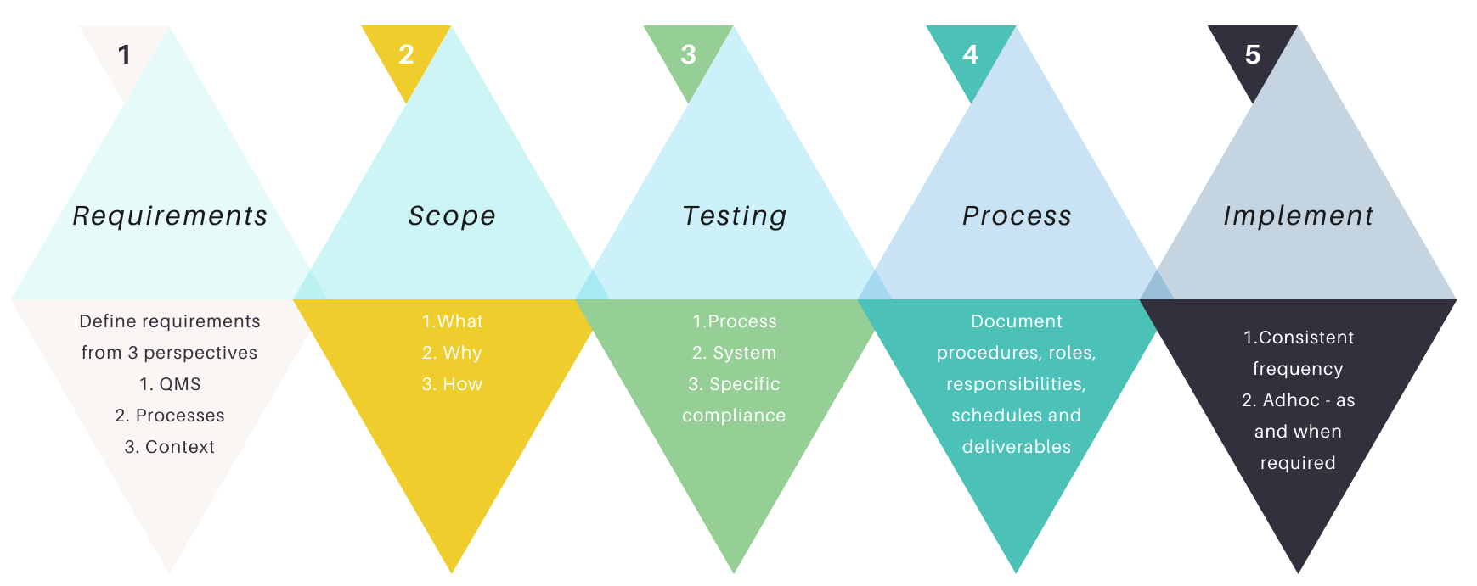
Quality Management
According to ISO, quality is defined as the degree to which a set of inherent characteristics fulfils requirements.
Quality management is about meeting or exceeding customer expectations and requirements consistently.
To ensure that project activities (analysis, design, development, testing, etc) are effective and efficiency
In quality management process, we use policies and procedures to implement the organisation’s quality management system
Isolocity.com

Slide 29
Quality Management Process
Quality Planning: identifying quality standards, determining the quality assurance and control activities
Quality Assurance (QA): activities such as code reviews, static analysis, unit testing, peer reviews, and process compliance
Quality Control (QC): activities such as testing (e.g., functional testing, integration testing, system testing, regression testing), debugging
Continues Improvement: post-project reviews, analysing metrics and performance indicators, and implementing corrective and preventive actions (training, feedback, lesson learned, monitoring, etc)

Slide 30
Quality Standards
ISO 9000 is defined as a set of international standards on quality management and quality assurance
ISO/IEC 9126 Software engineering — Product quality: classifies software quality in a structured set of characteristics:
functionality:
reliability:
scalability:
usability:
efficiency:
maintainability:
portability:
range of features and capabilities provided by software to meet user requirements
ability of a software system to consistently perform its intended functions under specific conditions
ability of a software system to handle increasing workload or user demands
measure of how easy and intuitive it is for users to interact with
ability of a program to accomplish tasks with optimal use of resources
the ease with which a software system can be modified, updated, and extended over time
capability of a software system to be easily transferred or adapted to different environments

Slide 31
Software Assurance Methods
Lines of codes (LOC): 3 levels of :
Industry average: 15 - 50 errors per 1000 lines of delivered code
Microsoft application: 10 - 20 defects per 1000 lines of code
Cleanroom development: 3 defects per 1000 lines of code
Software Inspection: code examination in detail by external agents
Peer review: code inspection by two or three colleagues from another project
Programming in pair: Both programmers sharing a single workstation to code and control at same time
Unit testing: testing individual units or components of a software application.

Slide 32
Capability Maturity Model
CMM is a methodology used to develop and refine an organization's software development process
developed by the Software Engineering Institute (SEI)
CMM's five levels of maturity for software processes:
Initial. At the initial level, processes are disorganized, because not all requirements are known
Repeatable: basic project management techniques are established
Defined. an organization develops its own standard software development process.
Managed. an organization monitors and controls its own processes through data collection and analysis.
Optimising. processes are constantly improved through monitoring feedback from processes .

Slide 33
Short Activity
Share your experience with the class on the quality of the software application you have used?
Which of those software you found to have good quality? What are your measurement factor?
Which of those software you found of having poor quality? What are your justifications?

Slide 34
Project Controlling & Monitoring
The process of tracking progress is used after the plan has been completed
A Baseline set which records the status of a project at a point of time
Monitoring is important to help predict problems as early as possible, and thus minimise the impact of problems on the successful completion of the project
To adjust project plan
To indicate which tasks are ahead of time or behind time, sometimes by displaying the Progress Lines.
In summary, to measure and report project progress

Slide 35
Burn Down/Up Chart
A burn down chart is a graphical representation of work left to do versus time.
The outstanding work (or backlog) is often on the vertical axis, with time along the horizontal.
It is often used in agile software development methodologies such as Scrum

Slide 36
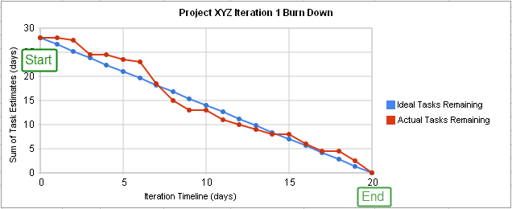
Burn Down/Up Chart
SampleBurndownChart.svg

Slide 37
Managing People
People are an organisation’s most important assets.
The tasks of a manager are essentially people-oriented. Unless there is some understanding of people, management will be unsuccessful.
Poor people management is an important contributor to project failure.

Slide 38
People Management Principles
Consistency
Team members should all be treated in a comparable way without favorites or discrimination.
Respect
Different team members have different skills and these differences should be respected.
Inclusion
Involve all team members and make sure that people’s views are considered.
Honesty
You should always be honest about what is going well and what is going badly in a project.

Slide 39
Motivating People
An important role of a manager is to motivate the people working on a project.
Motivation means organising the work and the working environment to encourage people to work effectively.
If people are not motivated, they will not be interested in the work they are doing. They will work slowly, be more likely to make mistakes and will not contribute to the broader goals of the team or the organisation.
Motivation is a complex issue and there are different types of motivation based on:
Basic needs (e.g. food, sleep, etc.);
Personal needs (e.g. respect, self-esteem);
Social needs (e.g. to be accepted as part of a group).

Slide 40



Human Needs Hierarchy
(Sommerville, 2016 )

Slide 41
Teamwork
Most software engineering is a group activity.
The development schedule for most non-trivial software projects is such that they cannot be completed by one person working alone.
A good group is cohesive and has a team spirit. The people involved are motivated by the success of the group as well as by their own personal goals.
Group interaction is a key determinant of group performance.
Flexibility in group composition is limited.
Managers must do the best they can with available people.

Slide 42
The Effectiveness Of A Team
The people in the group
You need a mix of people in a project group as software development involves diverse activities such as negotiating with clients, programming, testing and documentation.
The group organisation
A group should be organised so that individuals can contribute to the best of their abilities and tasks can be completed as expected.
Technical and managerial communications
Good communications between group members, and between the software engineering team and other project stakeholders, is essential.

Slide 43
Selecting Group Members
A manager or team leader’s job is to create a cohesive group and organize their group so that they can work together effectively.
This involves creating a group with the right balance of technical skills and personalities, and organising that group so that the members work together effectively.

Slide 44
Assembling A Team
May not be possible to appoint the ideal people to work on a project.
Project budget may not allow for the use of highly-paid staff;
Staff with the appropriate experience may not be available;
An organisation may wish to develop employee skills on a software project.
Managers must work within these constraints especially when there are shortages of trained staff.

Slide 45
Group Composition
Group composed of members who share the same motivation can be problematic. Some members are:
Task-oriented - everyone wants to do their own thing; OR
Self-oriented - everyone wants to be the boss; OR
Interaction-oriented - too much chatting, not enough work.
An effective group has a balance of all types.
This can be difficult to achieve as software engineers are often task-oriented.
Interaction-oriented people are very important as they can detect and defuse tensions that arise.

Slide 46
Group Organisation
The way that a group is organised affects the decisions that are made by that group, the ways that information is exchanged and the interactions between the development group and external project stakeholders.
Key questions include:
Should the project manager be the technical leader of the group?
Who will be involved in making critical technical decisions, and how will these be made?
How will interactions with external stakeholders and senior company management be handled?
How can groups integrate people who are not co-located?
How can knowledge be shared across the group?

Slide 47
Group Organisation
Small software engineering groups are usually organised informally without a rigid structure.
For large projects, there may be a hierarchical structure where different groups are responsible for different sub- projects.
Agile development is always based around an informal group on the principle that formal structure inhibits information exchange

Slide 48
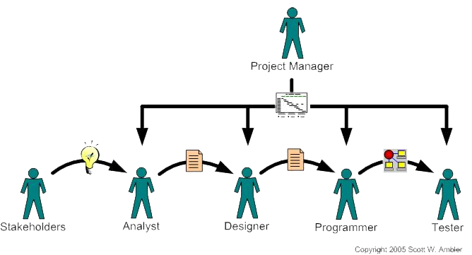
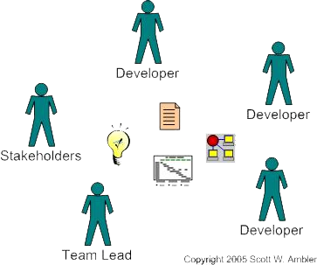
Development Team
A traditional software development team
VS
An agile software development team
Scott W. Ambler (2005) Generalizing Specialists: Improving Your IT Career Skills
Notes:
no arrows, why
developers (designers, programmers, an d tester) sitting with stakeholders, why? easy communication; agile for leader

Slide 49
Checkpoint Summary
Quality management process includes identifying standards for quality, quality assessment, quality control and quality monitoring
People management involves choosing the right people to work on a project and organising the team and its working environment.
People are motivated by interaction with other people, the recognition of management and their peers, and by being given opportunities for personal development.
Software development groups should be fairly small and cohesive. The key factors that influence the effectiveness of a group are the people in that group, the way that it is organized and the communication between group members.

Slide 50
Quiz
False or True:
Project management key elements are project scope, time and budget.
Motivation techniques for all team members should be same.
In contingency risk planning the probability that the risk will arise is reduced.
Software processes are variable and organization specific.
Fill the gap:
Two samples of factors influencing project management include ------------ and ----------------.
Risk management first stage is ---------------.
------------- is a tool used to monitor the progress of project.

Slide 51
Private Study
Considering the case study in next slides:
What actions should Alice as the project manager take to resolve the issue?

Slide 52
Case Study: Individual Motivation
Alice is a software project manager working in a company that develops alarm systems. This company wishes to enter the growing market of assistive technology to help elderly and disabled people live independently. Alice has been asked to lead a team of 6 developers that can develop new products based around the company’s alarm technology.
Alice’s assistive technology project starts well. Good working relationships develop within the team and creative new ideas are developed. The team decides to develop a peer-to- peer messaging system using digital televisions linked to the alarm network for communications. However, some months into the project, Alice notices that Dorothy, a hardware design expert, starts coming into work late, the quality of her work deteriorates and, increasingly, that she does not appear to be communicating with other members of the team.
Sommerville, 2016

Slide 53
Case Study
Alice talks about the problem informally with other team members to try to find out if Dorothy’s personal circumstances have changed, and if this might be affecting her work. They don’t know of anything, so Alice decides to talk with Dorothy to try to understand the problem.
After some initial denials that there is a problem, Dorothy admits that she has lost interest in the job. She expected that she would be able to develop and use her hardware interfacing skills. However, because of the product direction that has been chosen, she has little opportunity for this. Basically, she is working as a C programmer with other team members.
Although she admits that the work is challenging, she is concerned that she is not developing her interfacing skills. She is worried that finding a job that involves hardware interfacing will be difficult after this project. Because she does not want to upset the team by revealing that she is thinking about the next project, she has decided that it is best to minimise conversation with them.
Sommerville, 2016

Slide 54
The Unit Roadmap
Topic 1: Introduction
Topic 2: Introduction to Software Engineering Key Practices and Principles
Topic 3: Software Development Life Cycle Models
Topic 4: Requirement Engineering
Topic 5: System Modelling & Design
Topic 6: Software Implementation & Testing
Topic 7: System Dependency & Security
Topic 8: Project Management
Topic 9: Mini Project 1
Topic 10: Mini Project 2
Topic 11: Mini Project 3
Topic 12: Mini Project 4

Slide 55
Next Session – Topic 9
In the next session, you should be working on a mini project to:
Analyse and Plan the activities for the project
Gather Requirements of the project

Slide 56
References
Sommerville, I. (2016), Software Engineering, 10th edition

Slide 57
Topic 8 – Project Management
Any Questions?
Notes:
NCC Education - End Slide Master

